Slide 1
Billionaires wealth distribution
Mikhail Tirmare
Abhinav Agrawal
Ujwal Geed

Slide 2

Data Summary
This dataset contains statistics on the world's billionaires, including information about their businesses, industries, and personal details. It provides insights into the wealth distribution, business sectors, and demographics of billionaires worldwide.
Global Billionaire Insights: The dataset includes names, personal details, and business categories of billionaires worldwide, offering a comprehensive view of global wealth distribution.
Financial Metrics: Provides data on revenue, tax payments, and origin countries, enabling analysis of economic impact and tax contributions.
Socioeconomic Context: Incorporates education enrollment and GDP figures, facilitating the exploration of wealth dynamics within broader socioeconomic contexts.

Slide 3

OBJECTIVE
The project aims to analyze how billionaire wealth is distributed globally and offer strategies to create fairer and more sustainable economies. By understanding the factors that influence wealth accumulation among billionaires and addressing disparities, we aim to provide practical recommendations for policymakers and stakeholders to promote inclusive economic development.

Slide 4
Data cleaning using python
We have performed exploratory data analysis on the data to understand its structure, patterns, and relationships to get better insights into the data.
Then we performed data cleaning to remove unwanted values like null values using the data. isnull().sum() function.
This process eliminated unwanted rows, ensuring the dataset is suitable for data visualization.
Additionally, we utilized boxplots and heatmaps in Python to inspect the data before applying it in Tableau.

Slide 5
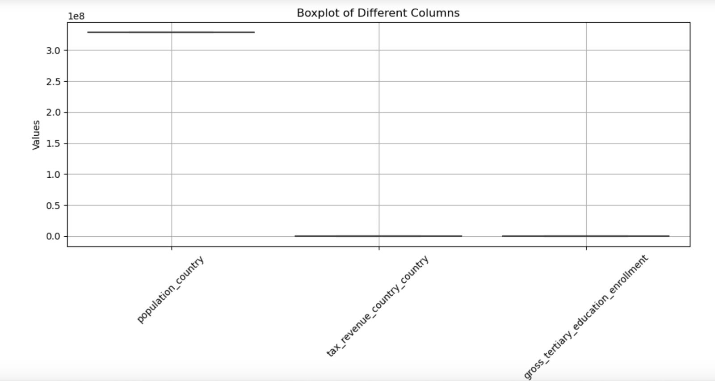
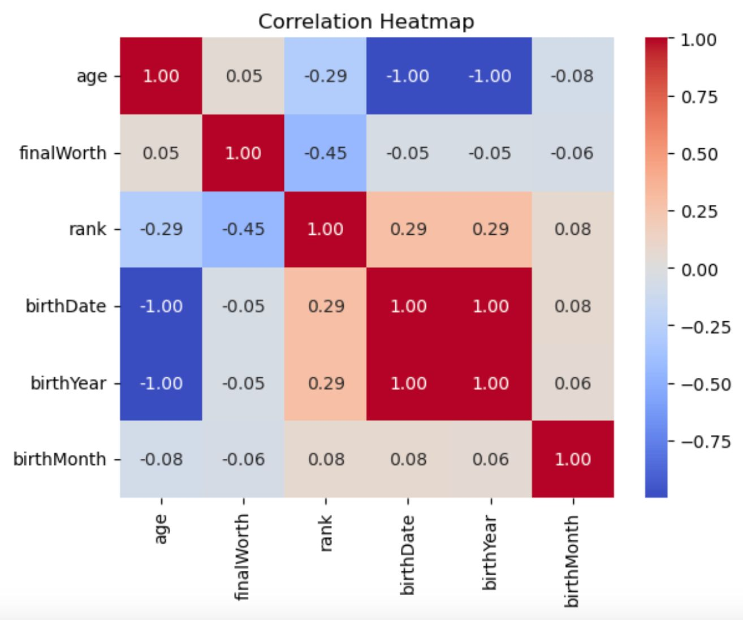
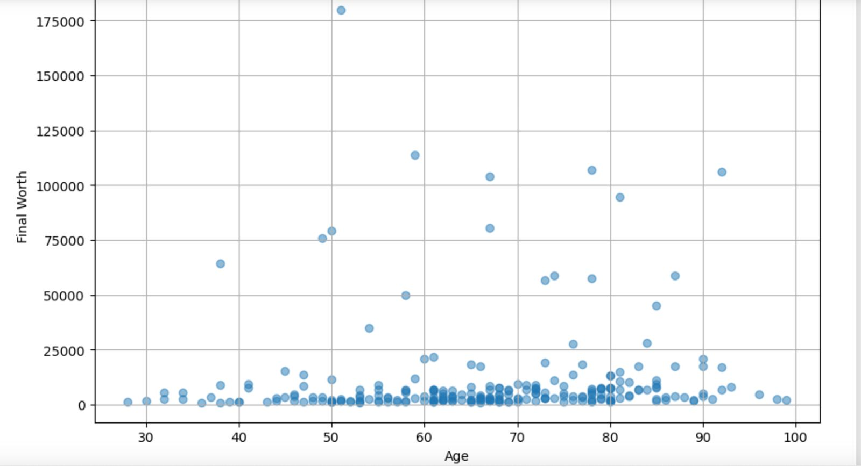
Visuals on python

Slide 6
Analyzing Data on Tableau
The bar graph illustrates the top 20 billionaires worldwide along with their respective net worth.
Bernard Arnault secures the first position with a worth of 211 billion.
Elon Musk and Jeff Bezos hold the second and third positions, with net worth of 180 billion and 114 billion respectively .
The remaining billionaires can be observed by following positions.

Slide 7
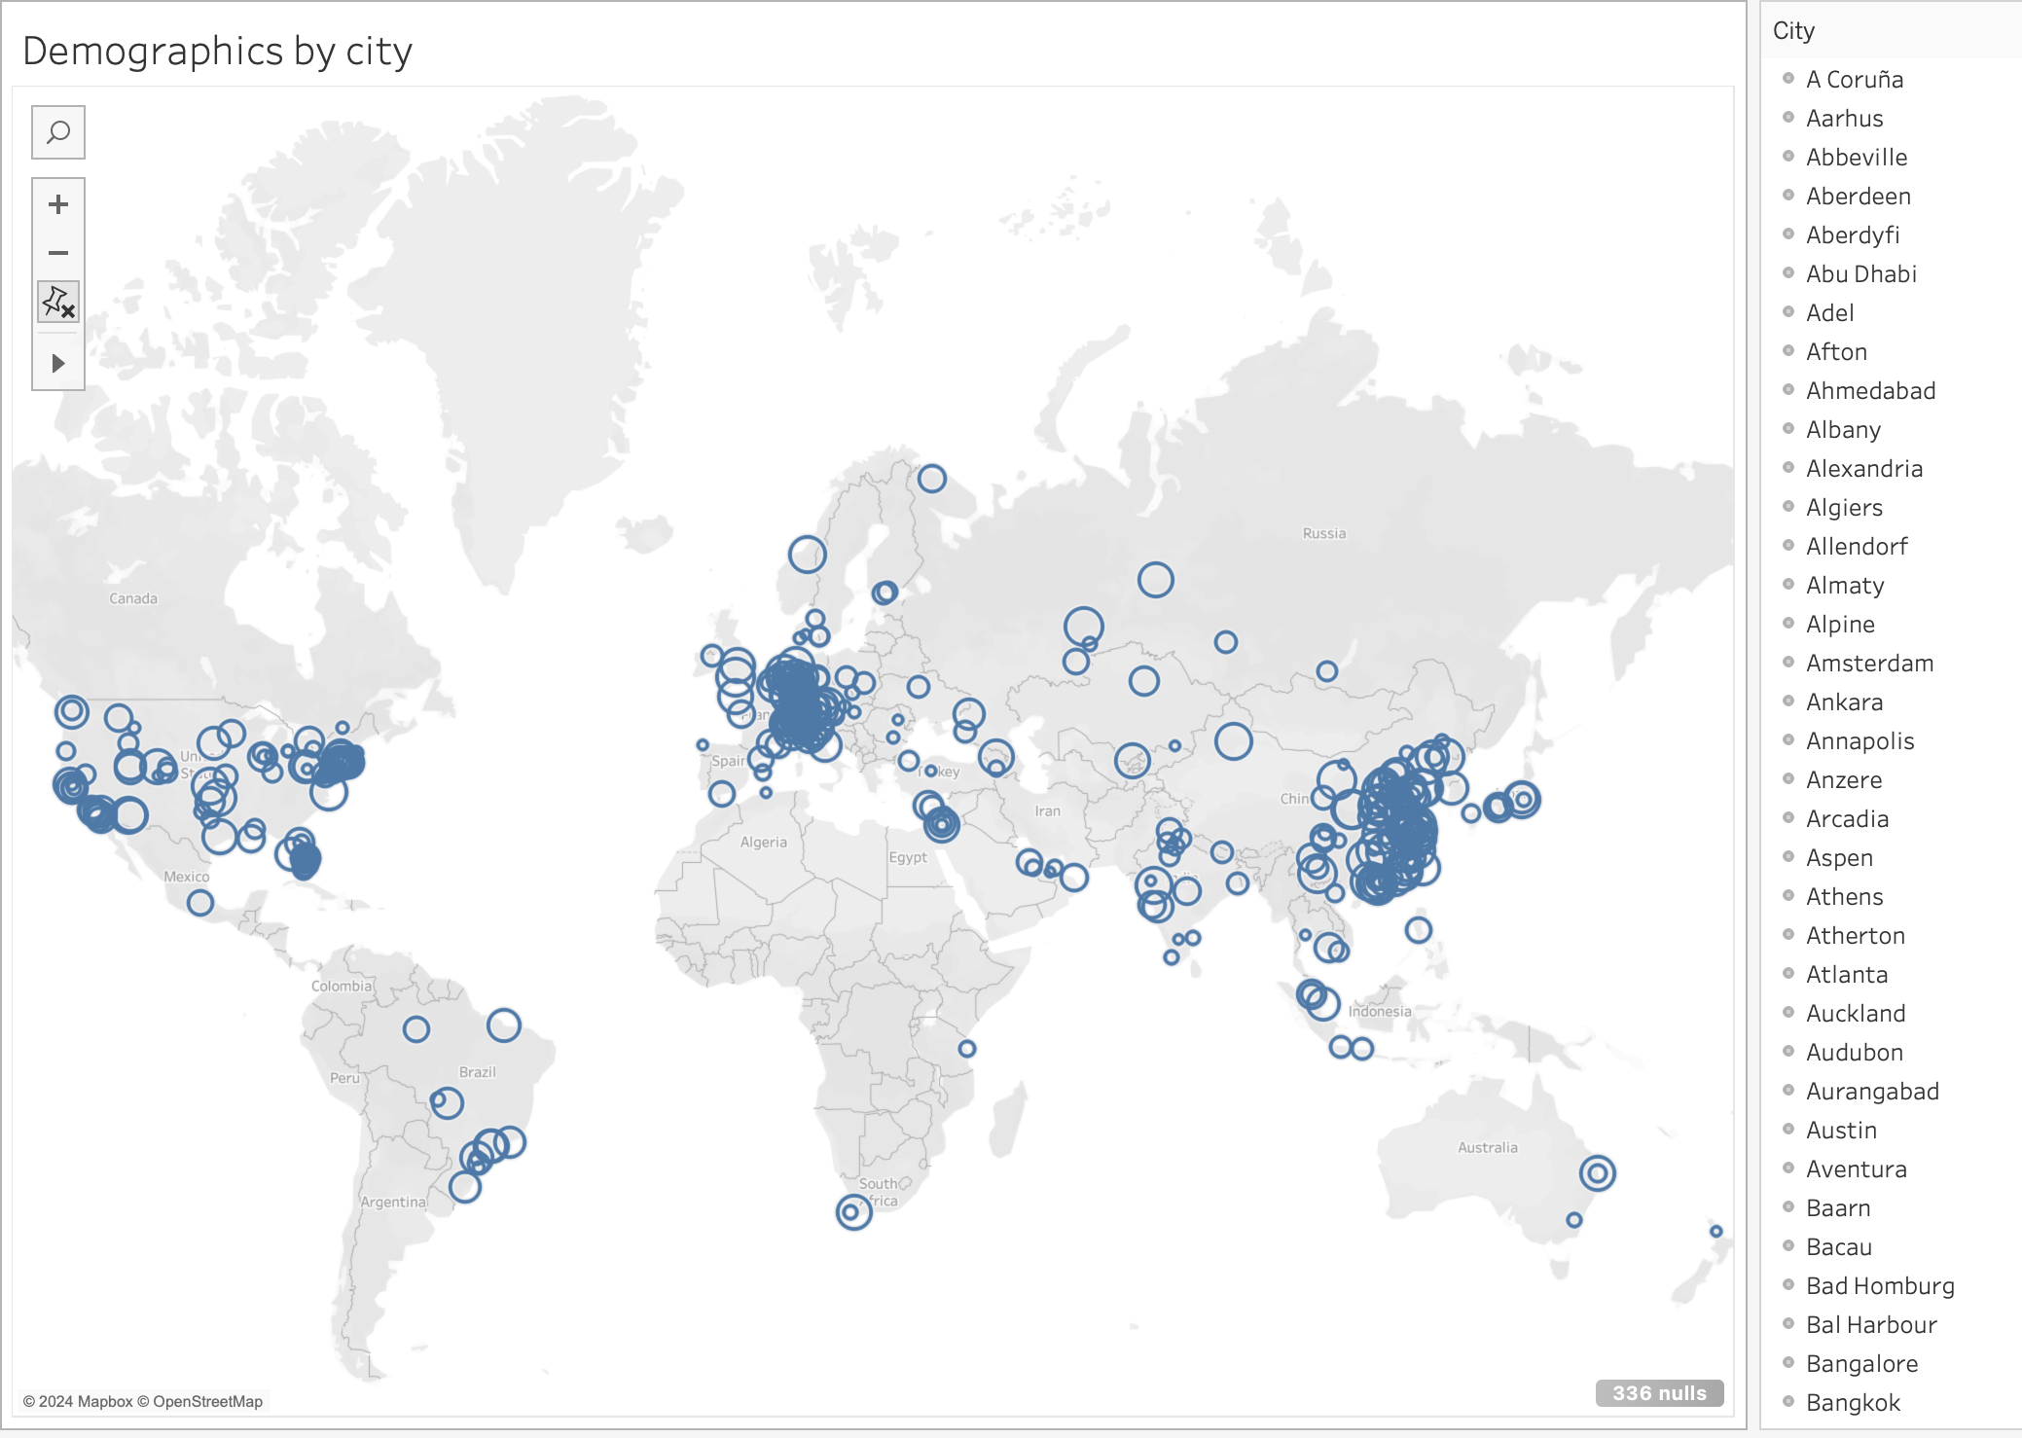
Demographic by city
We can analyze billionaires based on their respective countries.
In comparison to the rest of the world, China, Europe, and the USA exhibit a higher concentration of billionaires.

Slide 8
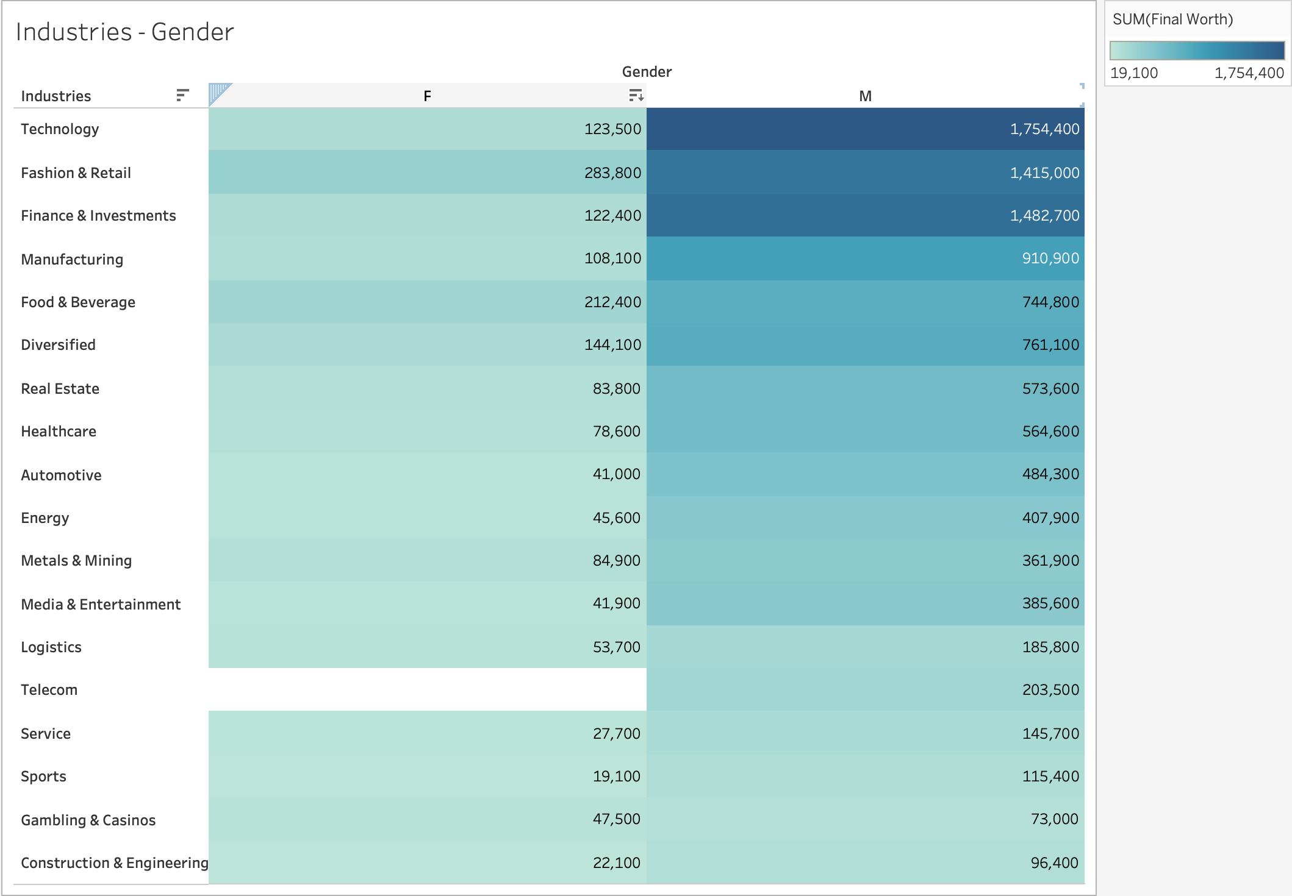
Industries - gender
The chart displays various business categories categorized by their respective industries.
Owners of these businesses are represented by both male and female genders. Among the top three industries - technology, fashion, and finance - the fashion industry notably has a higher proportion of female owners compared to the other two.

Slide 9
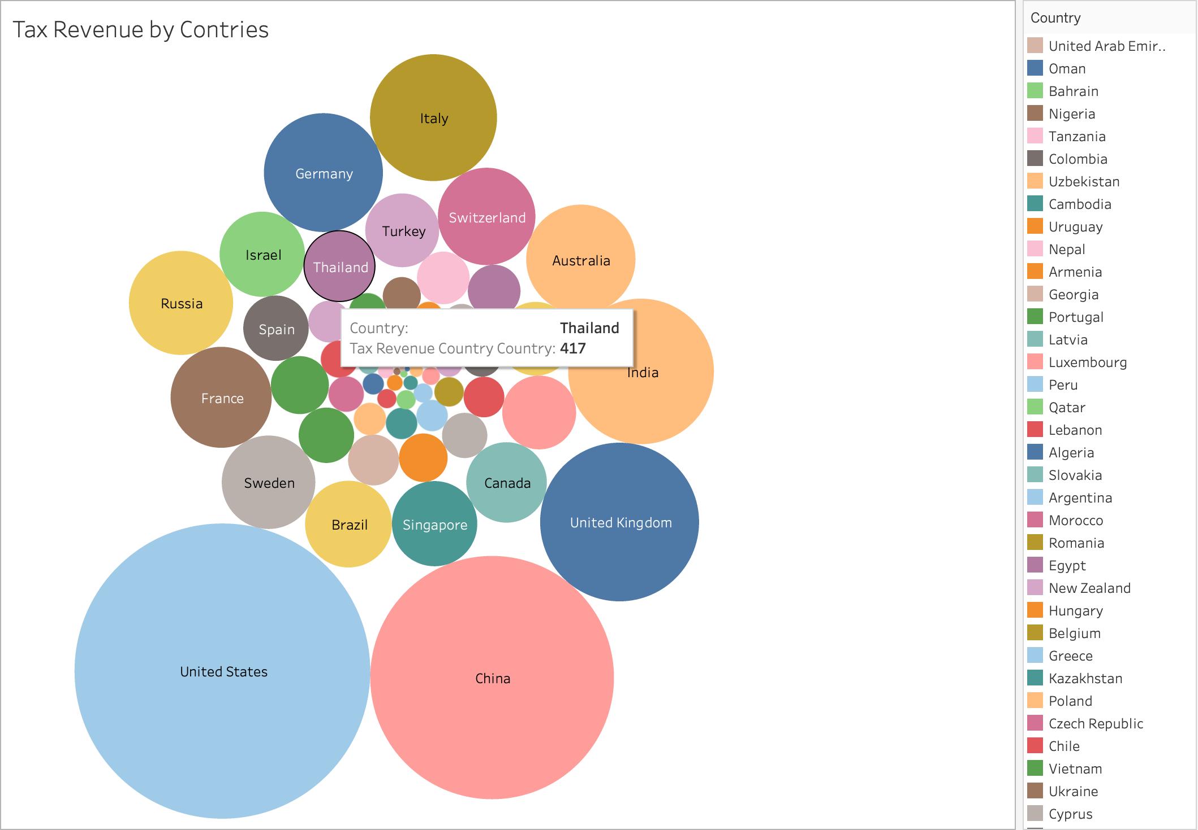
Tax revenue by countries
The bubble chart illustrates government revenue generated by respective countries, with bubble size corresponding to revenue magnitude; larger bubbles indicate higher revenue.
Analysis of the chart reveals that the United States leads in revenue, followed by China, UK, India, Germany, and Italy.

Slide 10
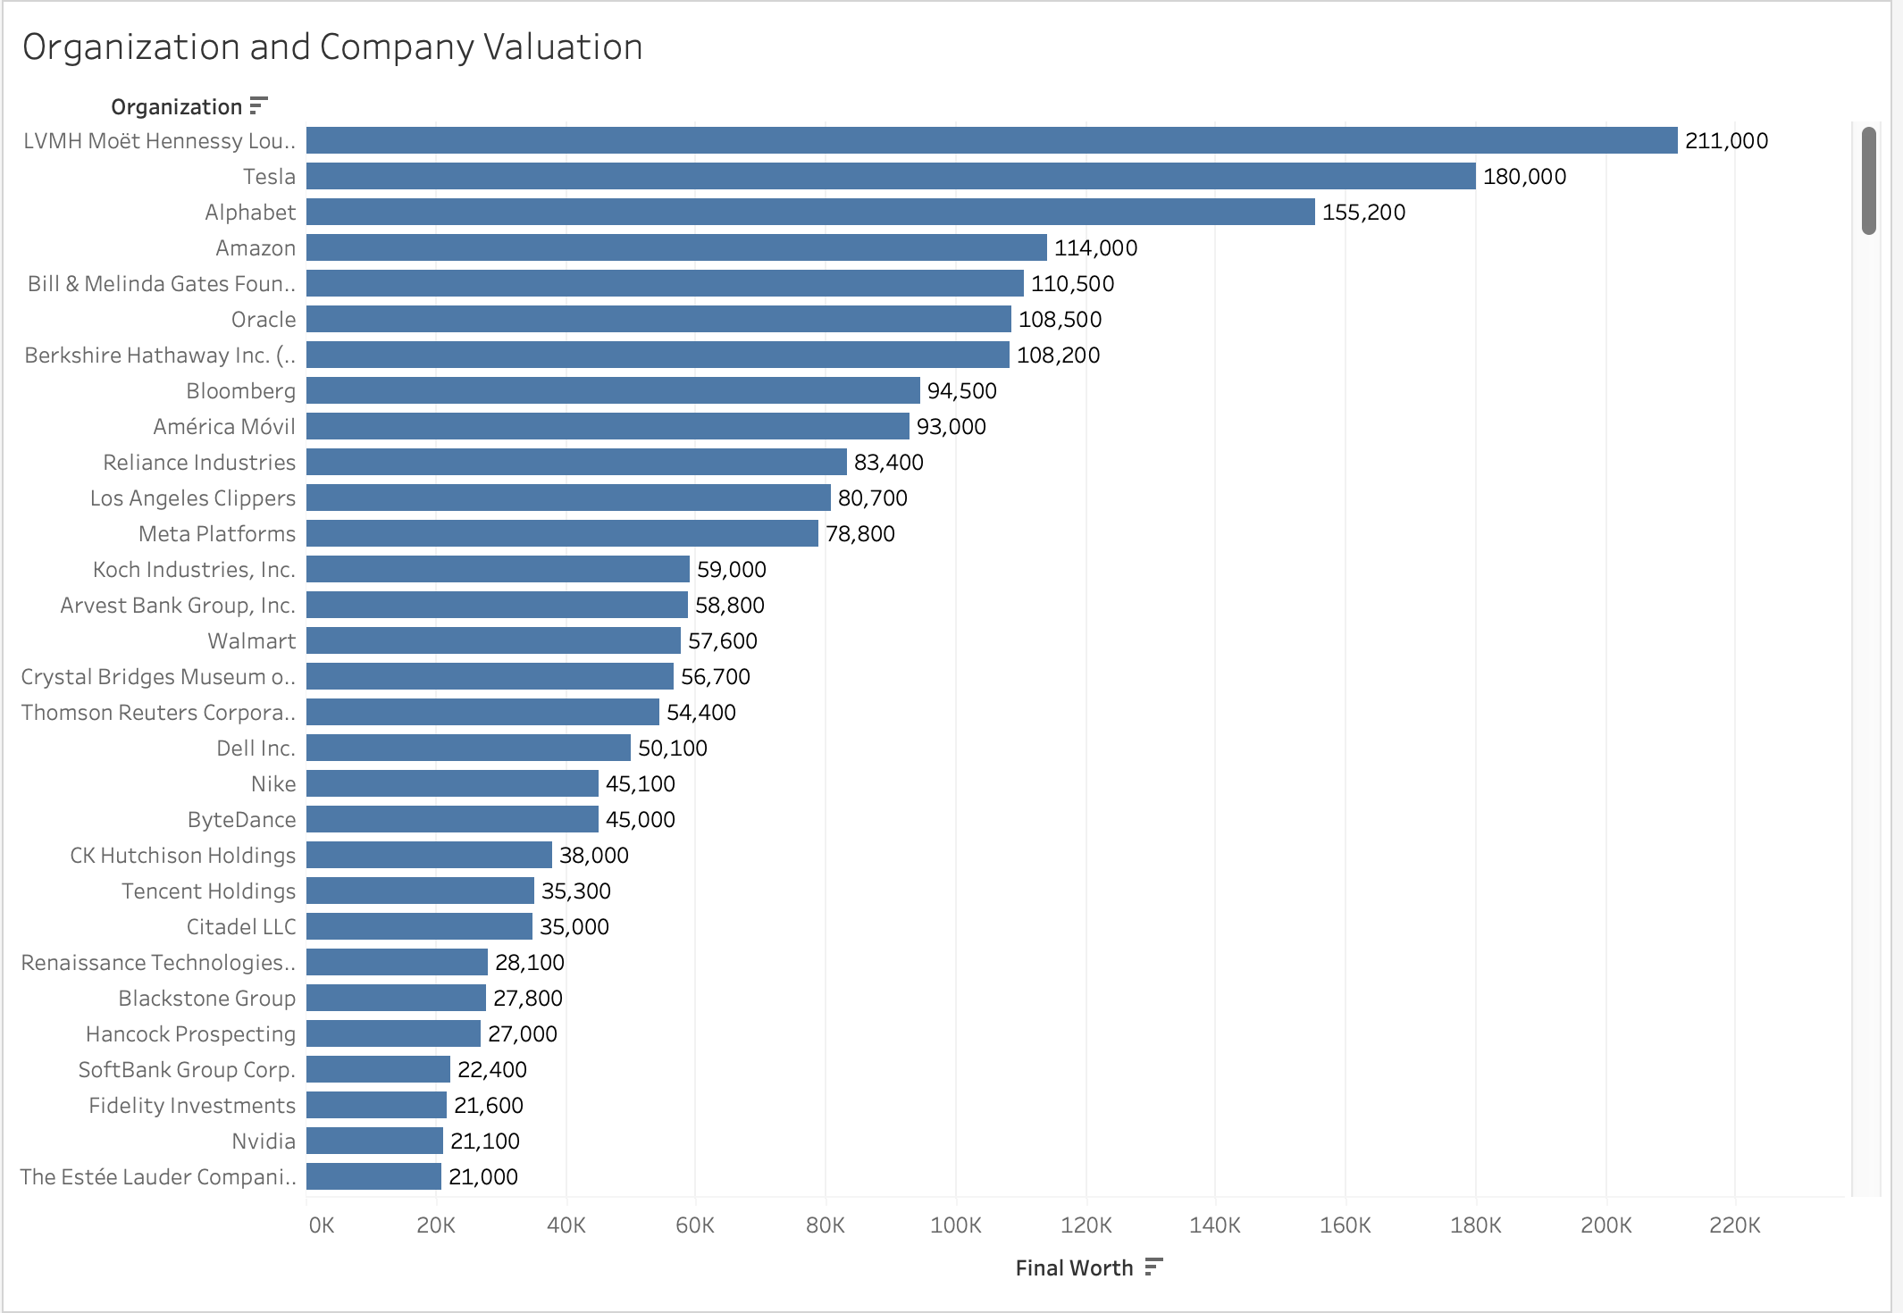
Organization and worth
The chart exhibits organizations along with their respective worth.
LVMH Moet Hennessy tops the list with a worth of 211 billion, securing the first rank.
Following are Tesla, Alphabet, and Amazon, holding the second, third, and fourth positions respectively.

Slide 11
Industry distribution
The pie chart illustrates the distribution of industries.
Technology occupies 15.38% of the total industry share, followed by fashion and finance at 13.92% and 13.15% respectively.
Other industries such as manufacturing and food & beverages account for 8.35% and 7.38% respectively.

Slide 12
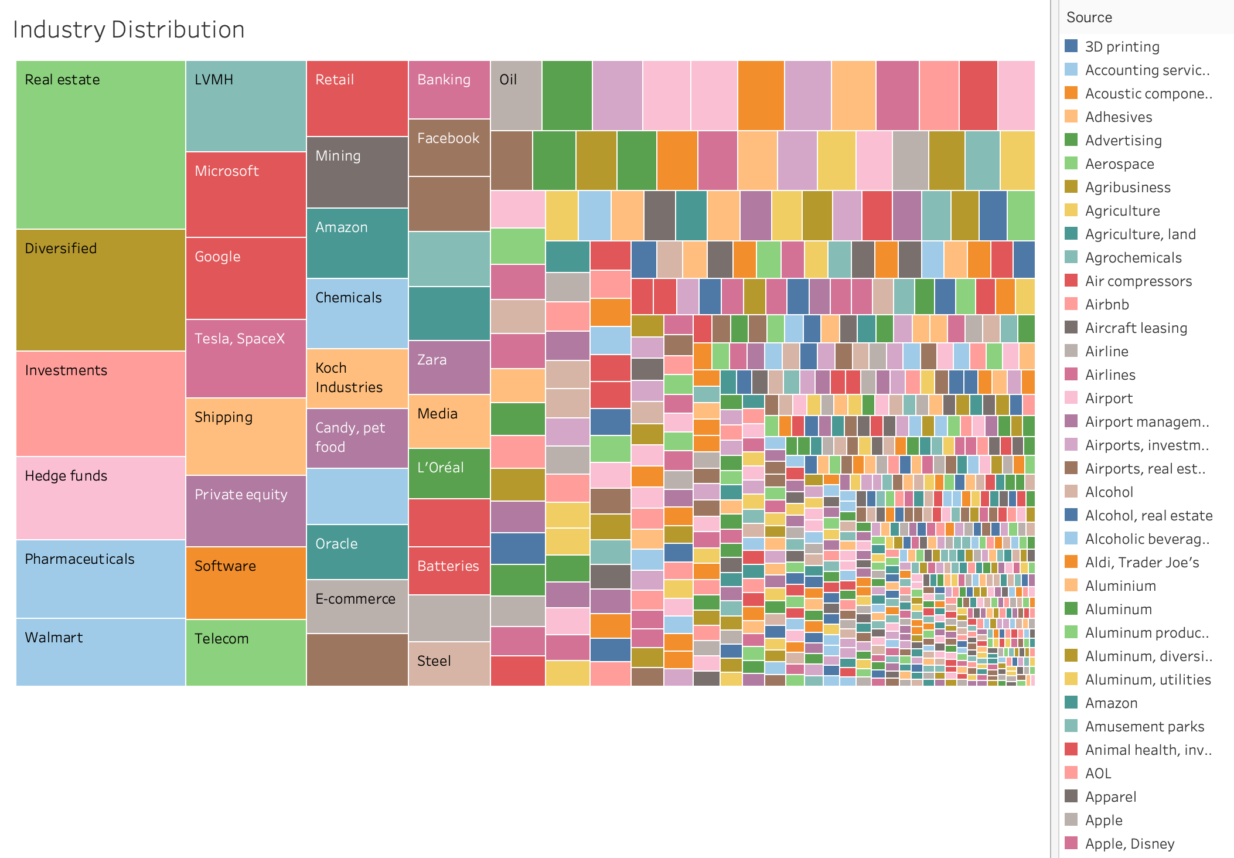
Source Distribution
This map illustrates the income sources of billionaires. Real estate is famous amongst billionaires when it comes to investment, Hedge funds and pharmaceutical follows after the real estate.

Slide 13
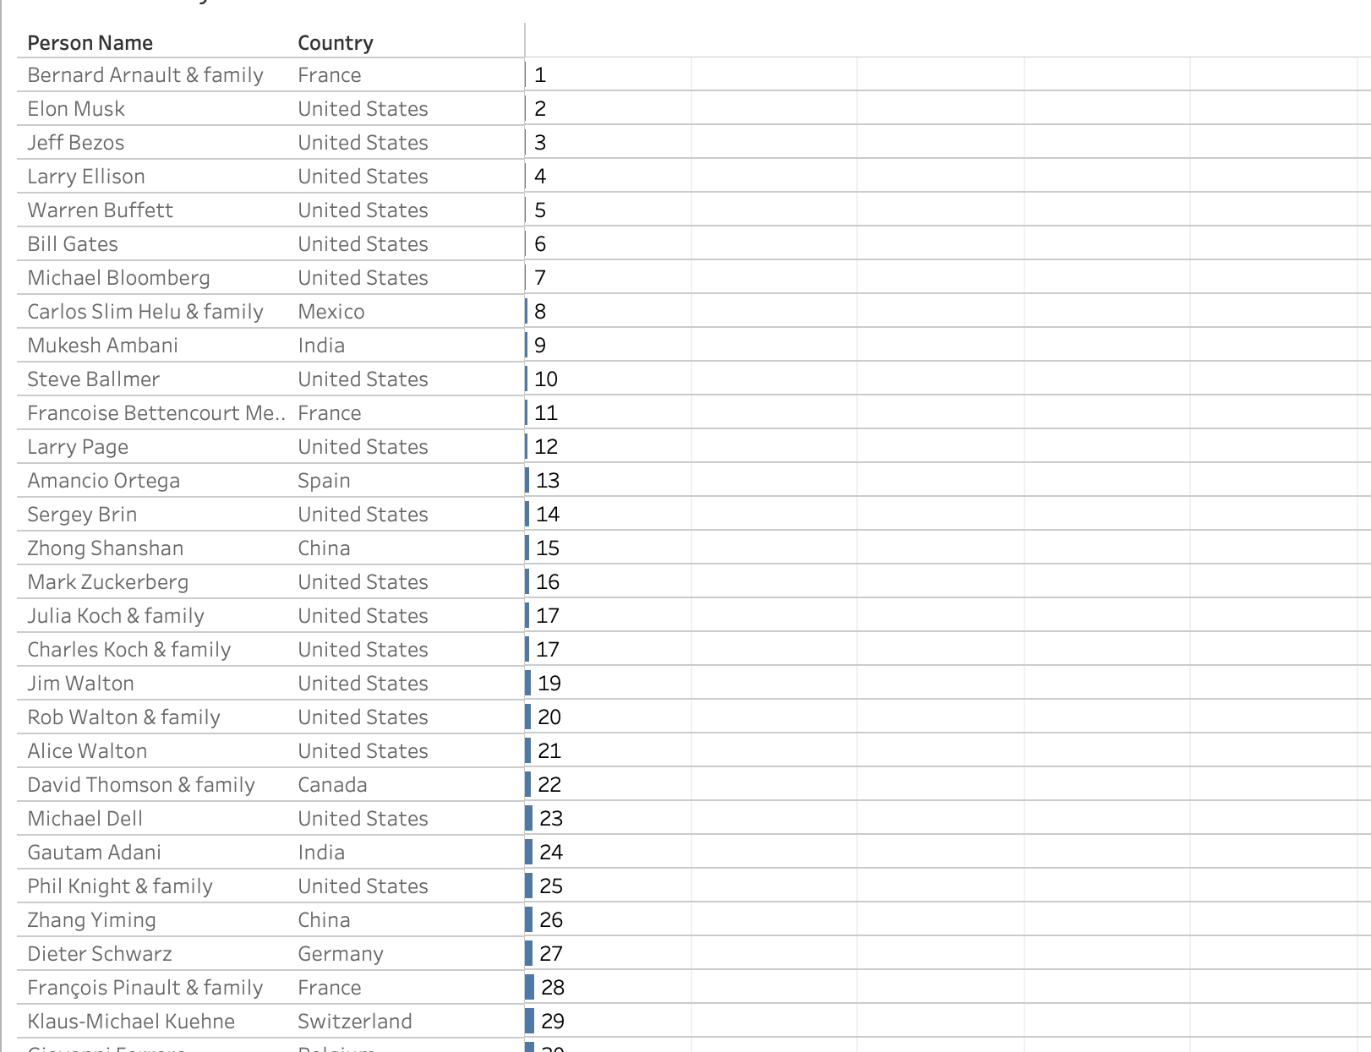
Billionaires by countries
The chart displays billionaires alongside their respective countries of residence or business operations, along with their corresponding ranks.

Slide 14
CONCLUSION
Wealth Distribution Disparities: Analysis of the dataset likely reveals significant disparities in billionaire wealth distribution across countries and industries. This could indicate systemic inequalities in access to wealth creation opportunities
Industry Trends: Examining the industries in which billionaires operate can provide insights into sectors that are particularly conducive to wealth accumulation. Identifying such trends can inform policies aimed at promoting equitable economic growth across diverse industries.
Geographic Patterns: The dataset may show geographic concentrations of billionaire wealth in certain regions or cities, reflecting regional economic dynamics and opportunities. Mostly, billionaires come from United states.
Overall, your project can contribute to the discourse on wealth inequality and provide actionable recommendations for promoting inclusive economic development and addressing systemic disparities.

Slide 15
STRATEGIC RECOMMENDATION
Overall, strategic recommendations should be tailored to create fairer and more stable economies, it's crucial for policymakers and stakeholders to understand the factors influencing billionaire wealth distribution globally. By customizing strategies to fit each situation and focusing on reducing inequalities, boosting economic growth, and ensuring opportunities for everyone, we can build a more inclusive and sustainable future.
These insights could be valuable for policymakers, economists, investors, and researchers interested in understanding global wealth distribution and its implications.

Slide 16

Thank you

